Slide 1
28 Nov. 2010- Cyborg& Non-Medical Drugs-Mohamed Gamal Mourad

Slide 2
Cyborg
The World’s Next Revolution In Human Life.

Slide 3
Introduction.
Origin of cyborg.
Cyborg in medicine.
Cyborg in art and popular culture.
Conclusion and outcomes.

Slide 4
INTRODUCTION.
WHO is cyborg?
WHAT is cyborg?
“cyborg” refers to human with bionic / robotic implants.

Slide 5
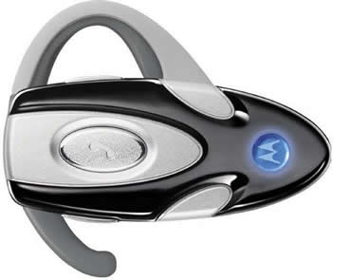
Is the cyborg present?
The answer depends on:
Cyborg is True
Or
Just Science Fiction.
Well, it is true.

Slide 6
So,
Where is CYBORG?

Slide 7
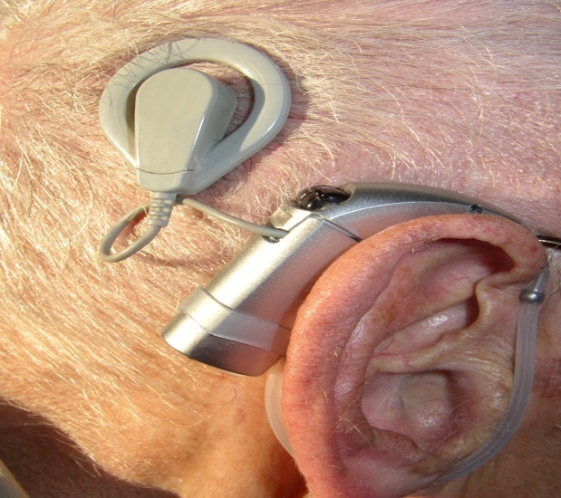
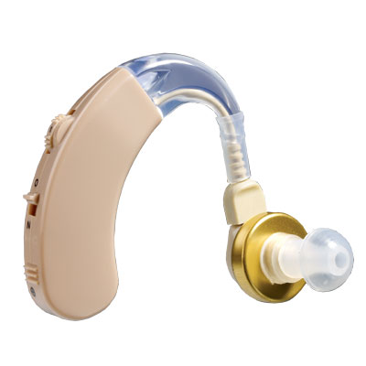
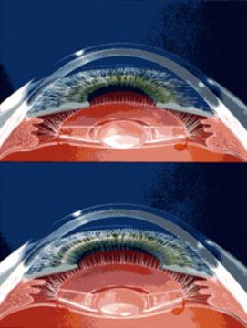
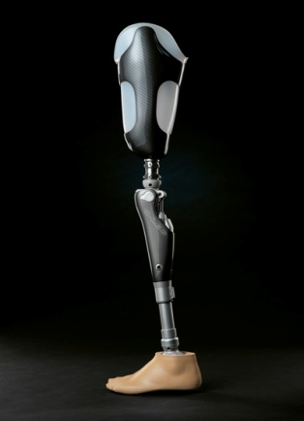
Cyborg is everywhere around us in people with
Cochlear implants
Hearing aids.
Intraocular lenses.
Artificial limbs.

Slide 8
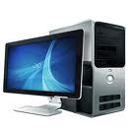
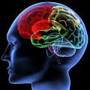
Origin Of Cyborg.
Cybernetics
The science of communication processes and automatic control system in both machines and living organisms.

Slide 9
Cyborg
Cybernetic
Organism

Slide 10
The concept of man-machine mixture → 1843 (science fiction).
The term “Cyborg” first mentioned 1960.
Manfred clyne's and Nathan Kline.
Article about self-regulating human-machine system in outer space.
How to intimate the relationship between man and machines for space exploration.

Slide 11
The need to be a cyborg.
Why CYBORG?

Slide 12
CYBORG.
Restorative
Normalizing
Reconfiguring
Enhancing

Slide 13
Restorative
Restore lost functions, organs and limbs
Normalizing
Get the congenitally malformed organ to the normal state
Reconfiguring
Get the missed functioned organ in accidents to the past condition.
Enhancing
Get the optimal performance
Maximizing outputs (information and modifications) and minimizing inputs(energy)
Enhanced cyborg exceeds normal processes or gain new functions.

Slide 14
Cyborg in medicine.
1
C-leg system and i-Limb

Slide 15
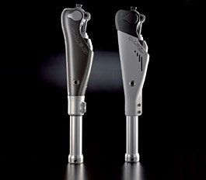
A) C-leg system
Replacing human leg that has been amputated in injury or illness.
Building components:-
1-microprocessor.
2-sensors.
3-hydraulic cylinders.

Slide 16
Microprocessor.
Receive signals from sensors.
Determine the type of motion
Send signals to hydraulic cylinders to act the proper motion
Sensors.
Measure the angular position and velocity of flexing joint.
This process take up less than 1/50 of a second.
Determine the applied force on foot or knee.
Hydraulic cylinders.
Regulating the rotation and extension of knee.

Slide 17
Advantages :-
Allow amputee to walk like normal non-amputee.
Allow walking down stairs
Can walk in hills and slopes
Stability.
Disadvantages.
Susceptible to water damage.
Used two months before getting accustomed
Can’t run with it
Battery stands 45 hrs. (12 volt).

Slide 18
C-leg System training

Slide 19
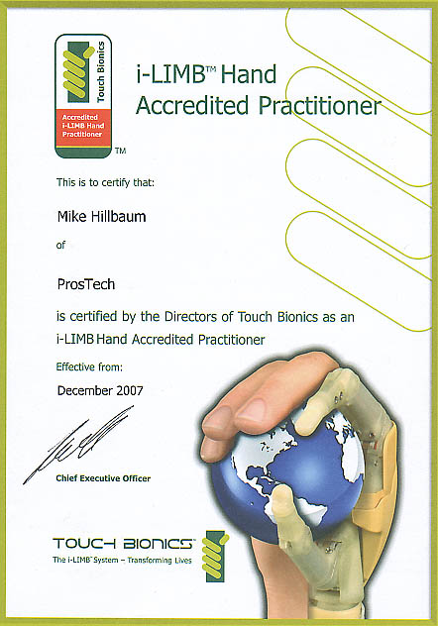
B) i-Limb.
Acts like a human hand
Prosthetic device with five individually powered digits.
Depend on myoelectric signals
Myoelectric controls utilize the electric signals of muscles

Slide 20
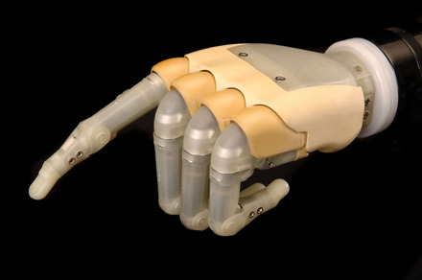
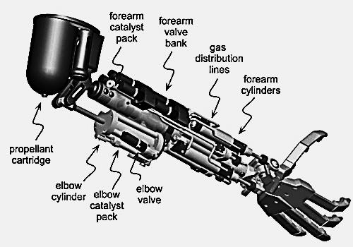
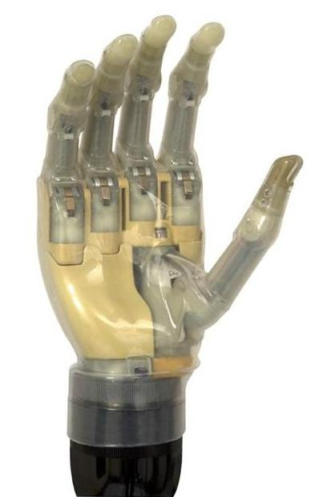

Slide 21
i-Limb System reviewing.

Slide 22
2
Eyeborg

Slide 23
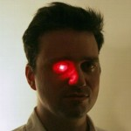
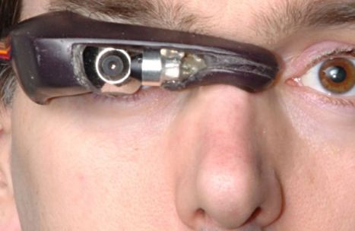
Cybernetic apparatus like normal eye.
Used by blind people or visual-impaired people (color blindness or achromatopsia)
Convert light waves to electric signals
This signals translated by microchip into photo with specific color and resolution.
Eyeborg was created in England ,2003 by Adam Montandon.
In 2007, Peter Kese , Slovenia increased NO. of color hues to 360 and add color saturation

Slide 24
